Slide 1

Sketch Recognition:
User Interface and CAD Integration
Andrew Danowitz
Christine Alvarado
Sarah Harris

Slide 2
UI and CAD: Motivation
To be effective as an educational tool, the sketch recognition program must introduce students to digital design tools
  Harvey Mudd digital design curricula uses Xilinx and Modelsim utilities
  Integrated sketch recognition will familiarize students with CAD tools
Integration with existing CAD tools increases the usability of the Sketch interface

Slide 3
UI and Communication: Design Overview
Goal: Add Sketch GUI as a design entry interface in Xilinx
Challenges to Xilinx Integration:
  Closed source program
  Lacks macro support
  Critical information not available through TCL interface
    Project Name
    Directory
  Circuit sketch recognition results must be translated into a format Xilinx understands

Slide 4
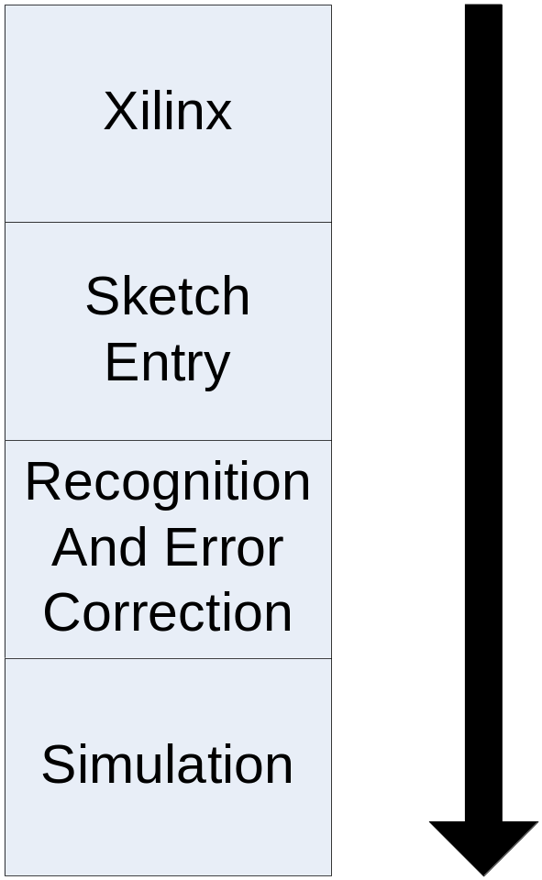
Project Flow
Sketch GUI launched from Xilinx TCL shell
User sketches circuit and truth table
Sketch GUI recognizes sketches
User corrects recognition errors
Sketch GUI adds circuit to Xilinx Project file and simulates in Modelsim

Slide 5
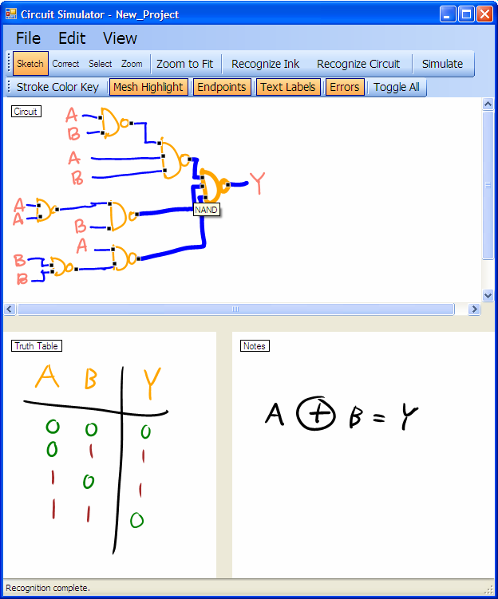
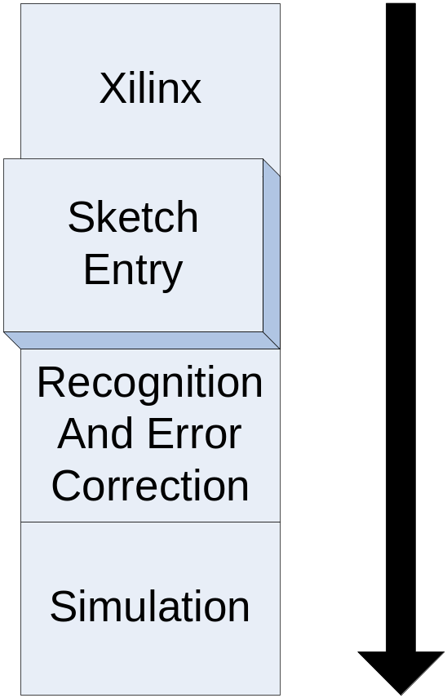
Design Solution: Sketch GUI
Sketch GUI consists of three sketch panels: circuit, truth table, and scratch-work

Slide 6
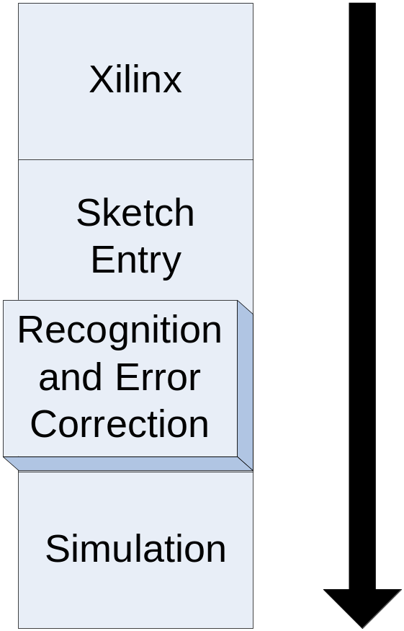
Design Solution: Recognition
Two-Stage Recognition:
  Recognize Ink
  Recognize Circuit

Slide 7
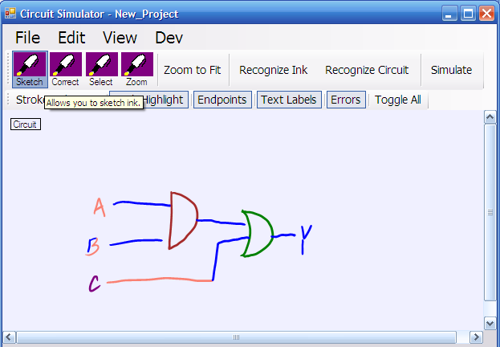
Design Solution: Ink Recognition
Sends contents sketch panel to circuit or truth table recognizer
Sketch GUI uses recognition results to color recognized components

Slide 8
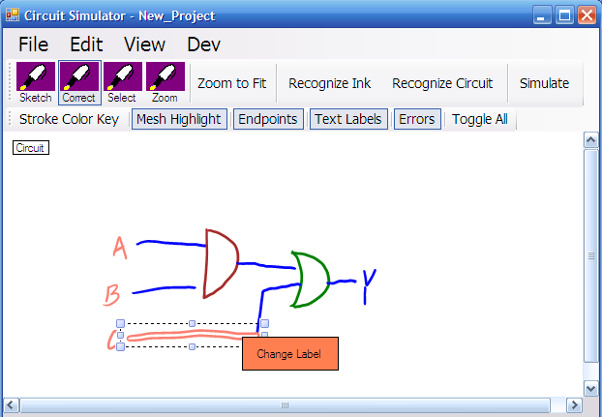
Design Solution: Correction
Users select mislabeled strokes with Correct Pen
Users select correct label

Slide 9
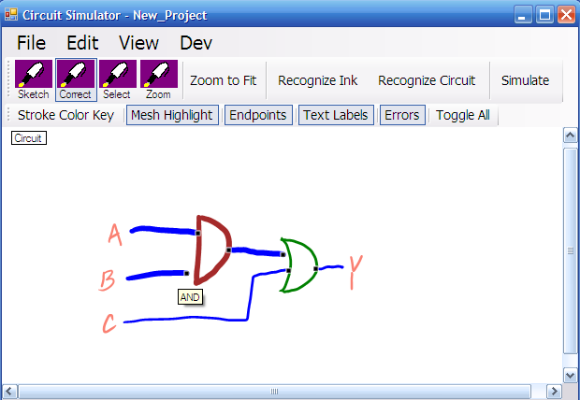
Design Solution: Circuit Recognition
Recognize Circuit determines connections between recognized elements

Slide 10
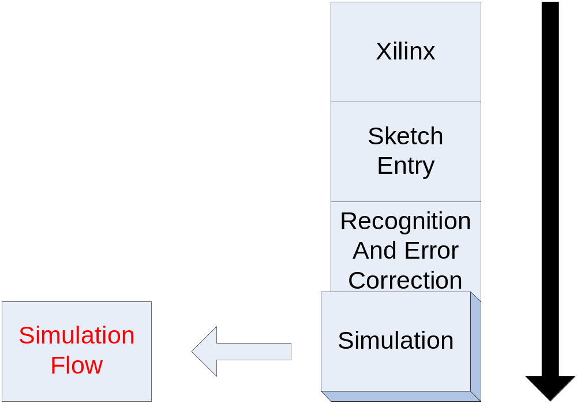
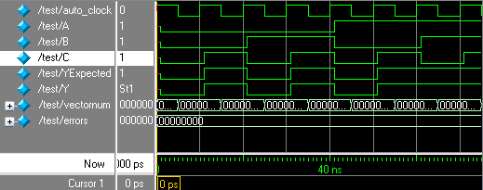
Design Solution: Simulation

Slide 11
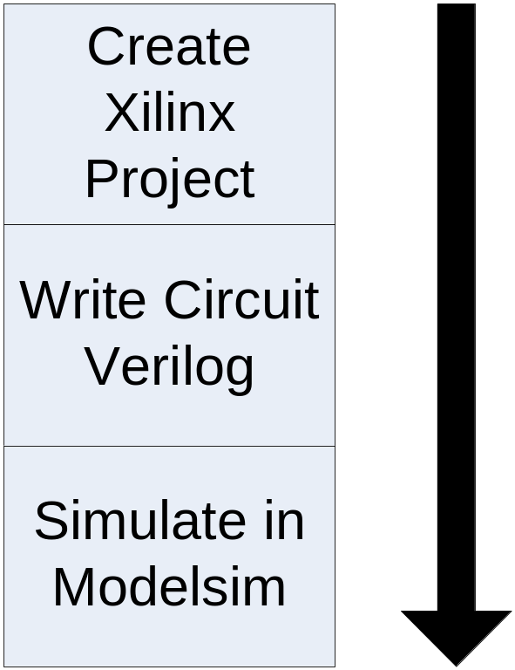
Simulation Flow
Sketch GUI sends recognition results to Simulation Flow
Circuit and Test bench Verilog Generated
Xilinx project created with generated Verilog
Verilog simulated in Modelsim
Simulation Flow

Slide 12
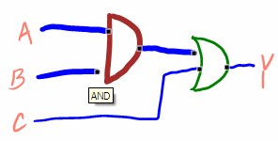
Design Solution: Generate Verilog
Circuit recognition results separated into gates, wires, inputs and outputs
Relationships between components printed out in the Verilog syntax to form circuit
Test bench generated from inputs and outputs (not pictured)
//////////////////////////////////////////////////////////////////////
//This circuit was automatically generated by
//VerilogWriter
//////////////////////////////////////////////////////////////////////
module jah(input[0:0] B, input[0:0] A, input[0:0] C, output[0:0] Y);
wire[0:0] INT_0;
assign INT_0 = B & A;
assign Y = C | INT_0;
endmodule

Slide 13
Design Solution: Create Xilinx Project
Writes script to create Xilinx Project File
Writes script to add Verilog modules to project
Executes both scripts sequentially through Xilinx TCL shell
Deletes scripts from directory
Sample TCL Script
#Xilinx Xtclsh script
#This script is automatically generated
#by Workpath
cd {c:\new_project}
project open lab1_xx
cd {c:\new_project}
catch {xfile add led.v} msg
catch {xfile add test.v} msg
cd {c:\new_project}
catch {project save_as lab1_xx} msg
project close

Slide 14
Design Solution: Modelsim Simulation
Generates custom Modelsim .fdo script
Load circuit and test bench Verilog
Set up simulation parameters
Simulate
Sample FDO Script
#Modelsim .fdo script
#This script is automatically generated
#by Workpath
vlib work
cd {c:\new_project}
vlog +acc "led.v"
vlog +acc "test.v"
vlog +acc "C:/Xilinx/verilog/src/glbl.v"
vsim -t 1ps -L xilinxcorelib_v -L unisims_ver -lib work test glbl
view wave
add wave *
add wave /glbl/GSR
do {test.udo}
view structure
view signals
run 1000ns

Slide 15
Conclusion
Given our current knowledge of Xilinx, complete Sketch GUI integration is not possible

Slide 16
Future Work
Expand VerilogWriter functionality for use beyond basic logic elements
Increase the level of integration between Sketch GUI and Xilinx Project Navigator

Slide 17
Questions?

